Slide 1

UNIVERSITY OF GHANA, LEGON (All rights reserved)
GROUP 2
Members
MICHELLE OWUSU – 10957340
MENSAH NYANYO HUBERT - 10976127
ANANE GEORGE NYARKO - 10947340
DERY-KUUZUME SANDRA - 10986424
APPIAH YAW FRIMPONG - 10987818
BENTIL B. REXFORD – 10946257
EVANS ACHEAMPONG - 10987644

Slide 2
Insurance Management System Introduction
The Insurance Management System project aims to develop an online application for an insurance company/agency to automate work procedures.
The system will provide a secure, user-friendly, and efficient database system for the management, agents, and customers of the agency.
The proposed system will eliminate the need for manual calculations, reduce paperwork, and provide quick access to stored data.

Slide 3
Problem Statement
Insurance companies/agencies rely on manual record-keeping using notebooks and pens.
This makes it difficult to keep records of every client and manage data effectively.
The existing system requires a lot of manpower, time, and resources.
There are no security measures against unauthorized access to data.
The system does not have any descriptive report to help management in decision-making.

Slide 4
Objectives
To develop an online application to automate the agent and client department for various purposes.
To automate manual calculations and easy retrieval of stored data.
To provide a secure, user-friendly, and efficient database system for the management, agents, and customers of the agency.
To increase productivity and reduce the chances of errors.

Slide 5
Proposed System
The proposed system will automate the agent and client department for various purposes.
The system will have three modules: Manager, Agent, and Customer.
The system will include tables for customer info, auto policies, homeowners policies, renters policies, and life insurance policies.
The database schema will avoid data redundancy, maintain data integrity, and organize data in a logical manner.

Slide 6
Manager Module
This module will be managed by managers from different branches for recruiting agents, registering customers, and calculating agents' commission based on their performance.
The manager module will have secure login credentials and access controls to prevent unauthorized access.
The module will generate reports on agent performance, customer details, and other necessary data to help management in decision-making.

Slide 7
Agent Module
This module will provide policy information for agents and commission information.
The agent module will include fields for personal details, manager details, and policies.
The module will generate reports on agent performance and policy details.

Slide 8
Customer Module
This module will allow customers to log in to their accounts and view policy percentages, total amount paid, and pending payment details.
The customer module will include fields for personal details and policy details.
The module will generate reports on customer policies and payments.

Slide 9
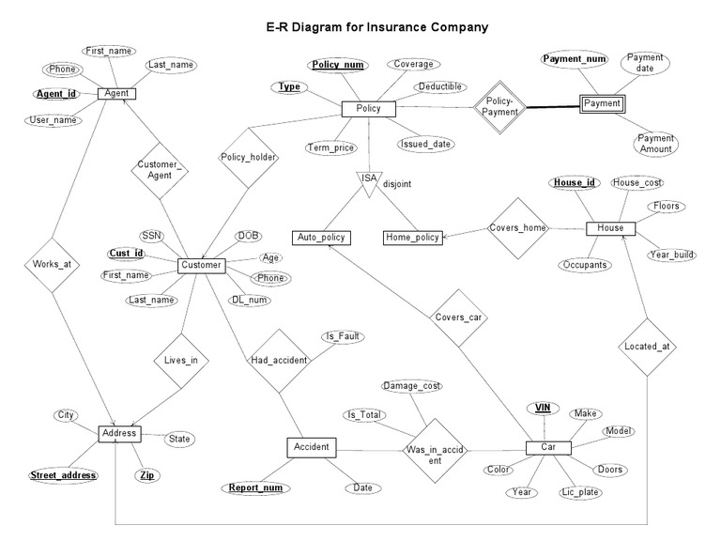

Slide 10
Conclusion
The Insurance Management System project aims to develop an online application for an insurance company/agency to automate work procedures.
The proposed system will provide a secure, user-friendly, and efficient database system for the management, agents, and customers of the agency.
By automating the system, the proposed system will increase productivity and reduce the chances of errors.

